Slide 1

August 7, 2019
Wifi: 1393Conference
Password: kayla1393

Slide 2

Welcome & Introductions
Your name
Your organization
Your mission
Your connection to population health
www.lihealthcollab.org

Slide 3
PHIP- A Refresher
Long Island’s
Population Health Improvement Program
www.lihealthcollab.org

Slide 4
What is a PHIP?
Region-wide entity coordinating and supporting public health initiatives for all populations
Bring diverse partners to the table to tackle stubborn health issues
Funded by a NYSDOH grant to service 11 regions in the state
Long Island Health Collaborative is contractor for LI region
Work guided by the state’s Prevention Agenda (PA)
  PA’s overarching goal is to improve health – neighborhood by neighborhood – legislative district by legislative district
  Two priorities chosen via data findings and group’s consensus
www.lihealthcollab.org

Slide 5
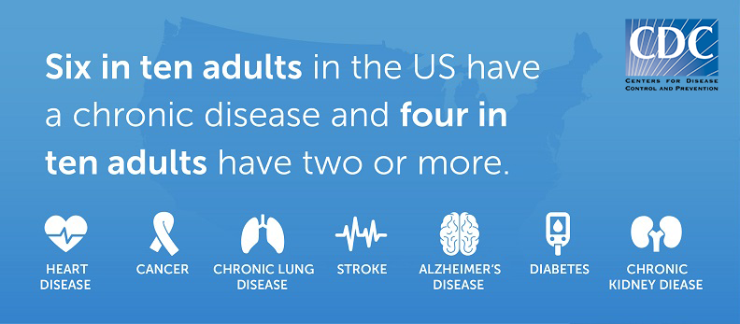
Our Priorities
Reducing incidence of chronic disease
Tackling mental health issues and substance use issues
Encouraging Lifestyle Change
Through the promotion of
Nutrition and Physical Activity
And the education surrounding
Social Determinants of Health
www.lihealthcollab.org
Notes:
Many mental health issues, such as depression and anxiety, are chronic conditions, as are the more serious mental health illnesses – such as bipolar disorder and schizophrenia. There is no sound physical health without sound mental health and vice versa.
Nutrition and physical activity – these two components have the most bearing upon chronic disease. Abundant evidence and research exists confirming that lifestyle changes in these areas can significantly improve and/or prevent chronic diseases and ensuing complications. We also know that without sound mental health, there is no good physical health.

Slide 6
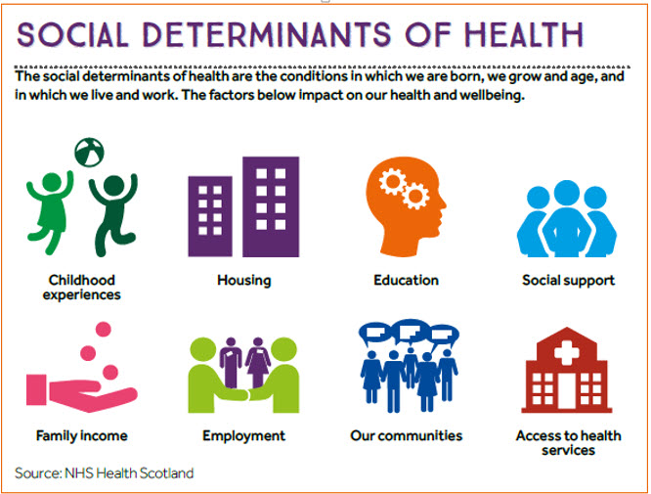
These social determinants of health, together with lifestyle choices, are about 70 percent responsible for health outcomes
www.lihealthcollab.org

Slide 7
Investment Shows Results
Annual award $600,000
LIHC collects and analyzes hyper-local data
Drives health planning and resource allocation for programming
Informs CHNA counties and hospitals required to conduct
  Service worth about $1.5 million in savings to region, leaves more money for other regional health planning needs
Our data analyses show
  Long Islanders’ consumption of fruit is improving
  Long Islanders’ physical activity levels show slight uptick
Collaborative members work in their own way to achieve improvements
  Saves the region millions in healthcare costs via avoidable hospital ED visits
  Improves individuals’ quality of life, work productivity, civic engagement
www.lihealthcollab.org
Notes:
Understanding that all healthcare is local – meaning every community, every neighborhood looks different and has its own unique health issues and challenges – requires an ability to look at data from a hyperlocal perspective. LIHC is able to do this via its primary collection tools – Community Health Assessment Survey – and the qualitative data collected via summits/focus groups, etc. On the flip side, all chronic disease drivers are universal – meaning that lifestyle choices – specifically food choices and access and physical activity levels – play a disproportionate role in health outcomes, chronic disease incidence.

Slide 8
Our Initiatives
Long Island “Healthy Libraries” interactive programming map
Walk with a Doc
Cultural Competency and Health Literacy TTT
Networking opportunities
Long Island Community Health Assessment Survey
Data aggregation and analysis
www.lihealthcollab.org

Slide 9
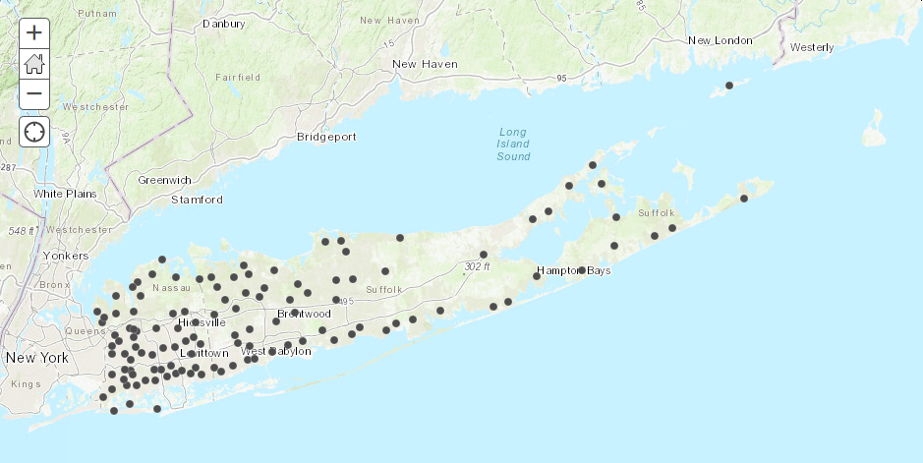
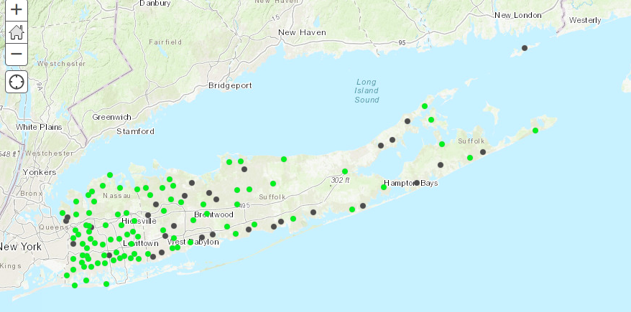
Initiatives-LI Healthy Libraries
This interactive map is housed on the Long Island Health Collaborative website as a tool for the public to identify basic library information. It indexes the different programs and resources that libraries may offer based on Prevention Agenda priority health topics and social and behavioral determinants of health.
www.lihealthcollab.org

Slide 10
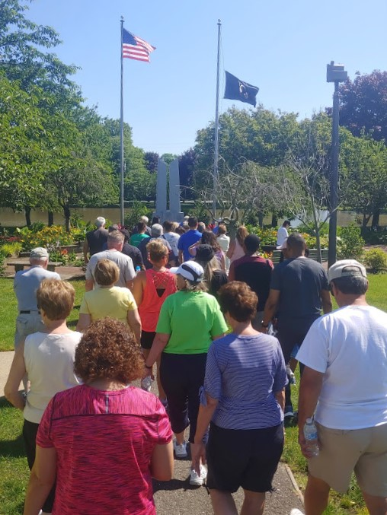
Initiatives-Walk with a Doc
A national program aimed at behavior change through simplicity and sustainability - A doctor gives a brief presentation on a health topic and then leads participants on a walk at their own pace.
Currently Long Island’s only chapter, led by Dr. Donato Balsamo of Amityville, and powered by the LIHC.
www.lihealthcollab.org

Slide 11
Toward Our Future
A promotional and data resource for the dozens of initiatives related to mental health and substance use disorders impacting Long Island
Raising awareness about need for self-management of chronic disease through public outreach campaign
New York State ranks second among states in medical expenditures attributable to obesity at $11.1 billion – (NYS BRFSS analysis)
Produce thematic data reports – September 2019: Binge Drinking
Assessing individuals’ and communities’ perceptions about health/social needs and barriers through Community Health Assessment Survey
www.lihealthcollab.org

Slide 12

Solutions and Takeaways
Funded by the state’s PHIP, the Long Island Health Collaborative is,
a data resource organizer and analyzer
the core of population health coordination
a constituent connector
Through solutions-oriented approaches, we serve to
Follow collective impact model
Leverage diverse partners
Foster linkages
Promote VBP concept
Eliminate redundancies
Streamline practices
Aggregate data
www.lihealthcollab.org
Notes:
The LIHC operates from a solutions-oriented approach. That means helping organizations identify partners with whom they can collaborate to bring about the greatest change - cost efficiently and effectively. True to the collective impact model, the LIHC is the backbone organization providing LIHC participants with the data, administrative support, and networking base to get the job done. Looking further down the road, we are also mindful of the powerful presence VBP contracting has and will continue to have, as the state’s healthcare delivery system continues to transform from volume to value. Our data analysis capabilities and reports will play a key role in ensuring that hospitals and organizations of every type and size have a meaningful and sustainable role in healthcare/social services delivery.

Slide 13

Overview of the NEW
Chronic Disease Self Management Program (CDSMP)
Initiative in Nassau and Suffolk Counties
from August 1 – November 29, 2019
Sponsored by:
The Long Island Health Collaborative
Presenters for Community Engagement Network (CEN):
Jose Moreno, CDSMP T-Trainer, Project Manager
Gloria Lopez, CDSMP Master Trainer & Community Outreach Coordinator
Arelne Rojas, CDSMP Master Trainer & Community Outreach Coordinator

Slide 14
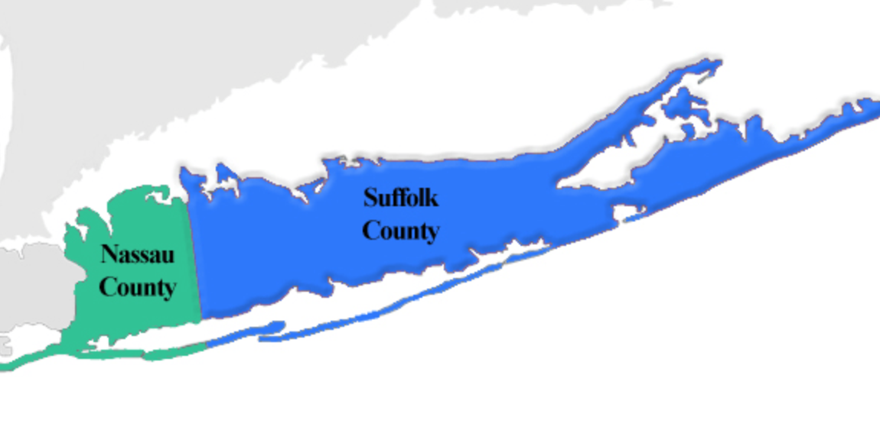

Initiative Overview
The evidenced-based Chronic Disease Self-Management Program (CDSMP) workshops are being offered in the counties of Nassau and Suffolk under the sponsorship of the Nassau-Suffolk Hospital Council through its Long Island Health Collaborative, the population health initiative on Long Island that is funded by the New York State Department of Health.
Community Engagement Network, LLC, has partnered with LIHC to offer the CDSMP to the Nassau and Suffolk communities in English and Spanish during the months of August through November 2019.
Workshops are being offered in English and Spanish to adults over 18 years of age at no cost to participants or partners.

Slide 15
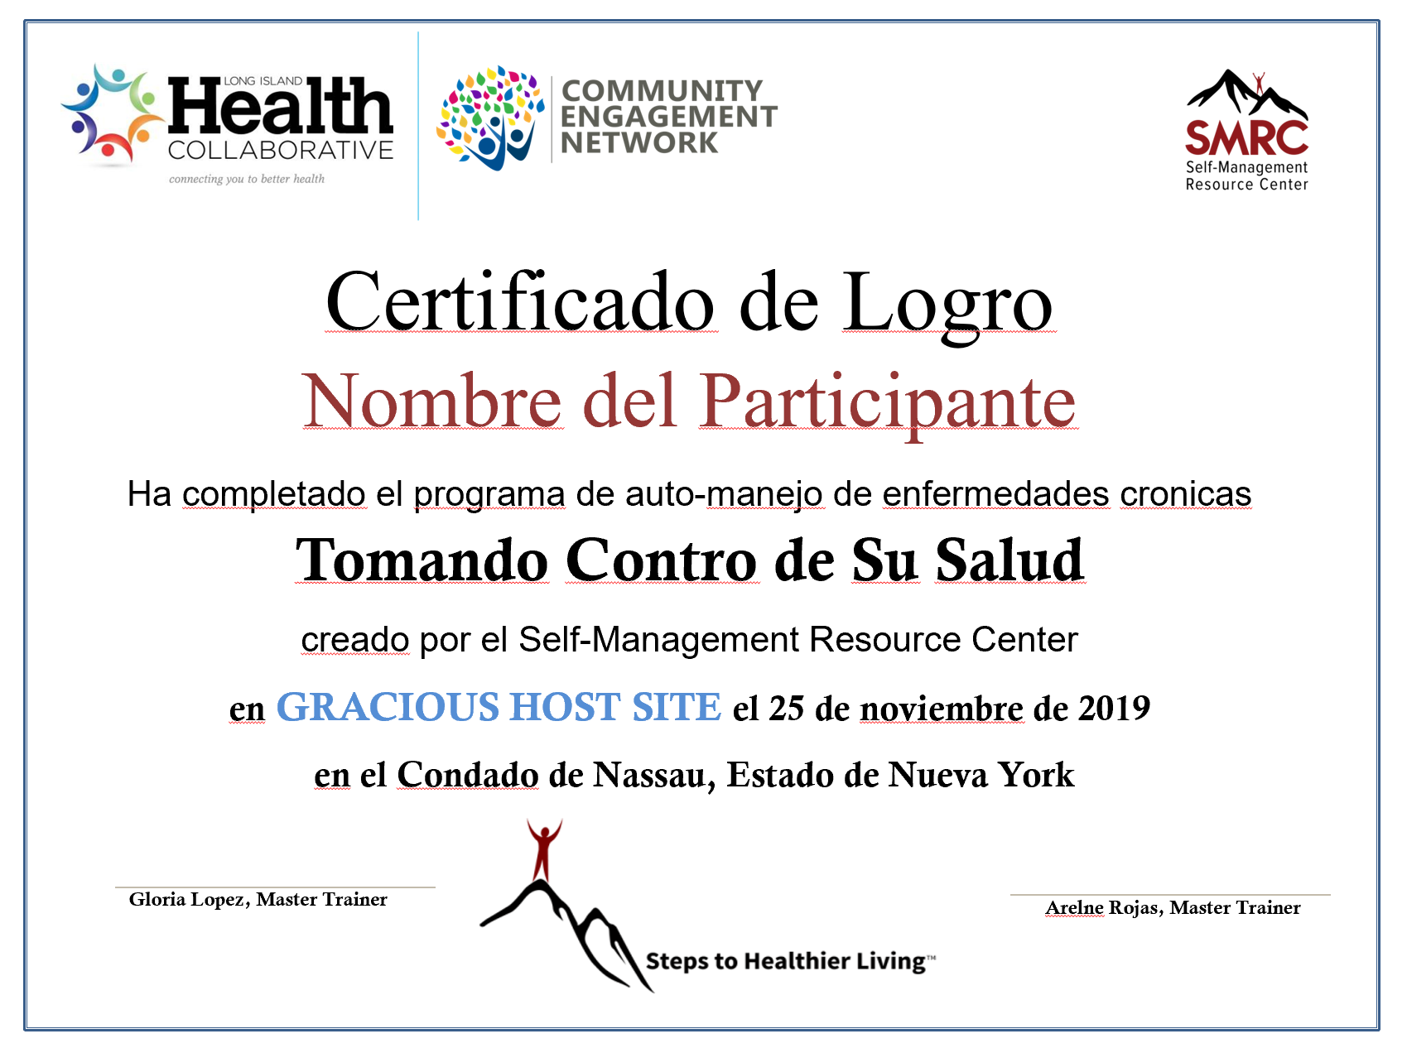
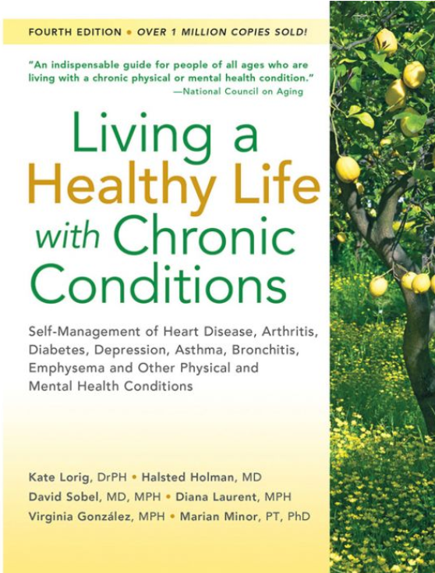

CDSMP Overview
The CDSMP is a six-week interactive workshop that provides hands-on interactive and fun education for people and their families or care partners who are living with chronic conditions.
The workshop is also geared for family members and partners who care for loved ones living with chronic diseases.
The program covers topics such as healthy eating, easy-to-follow physical activity exercises, stress management, medication management, and improving communications with their healthcare team among others in a supporting environment.
Workshops are once a week for 2.5 hours at your location (host sites).
Participants will receive a certificate of achievement, the book “Living a Healthy Life with Chronic Conditions” ($20.00 value) and a gift bag.
The LIHC is covering the cost of these items, and all costs associated with the workshops!

Slide 16
Our goal is to graduate 100 participants by
November 29, 2019 (approximately 10 workshops)
We need your help with:
Site referrals - any sites are not familiar with the partnering organizations and require validation from a trusted source or contact person.
Sharing the overview letter via e-mail with your partners
Invite us to talk to your networking events
Other ideas? Who are we missing?

Slide 17

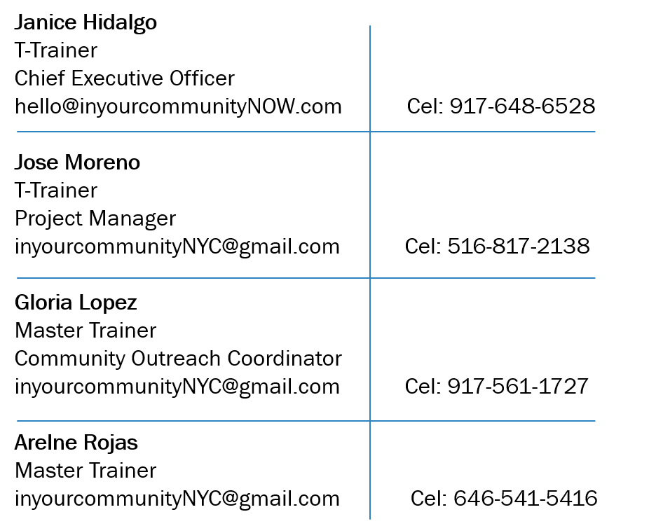
About CEN
CEN’s staff has a wealth of experience and proven capacity and has been a leader in the successful dissemination and delivery of evidence-based programs, such as CDSMP, health promotion workshops, and wellness activities throughout NYC, Upstate NY, New Jersey and Puerto Rico for the past ten years.
CEN staff and affiliates have delivered CDSMP and other self-management programs contributing to graduating more than 10,000 participants since 2009.
CEN is a minority-owned, women-owned business.

Slide 18
Thank You for Your Time
Questions and Discussion

Slide 19

Association for Mental Health & Wellness
Anne Marie Montijo, LCSW
Deputy Director for Strategic Initiatives
amontijo@mhaw.org
(631) 471-7242 x1432
www.lihealthcollab.org

Slide 20


Western Suffolk BOCES
Karyn Kirschbaum, Ph. D.
School Health Policy Coordinator
kkirschb@wsboces.org
(631) 595-6816
www.lihealthcollab.org

Slide 21

Nassau Library System
Caroline Ashby
Director
cashby@nassaulibrary.org
(631) 595-6816
www.lihealthcollab.org

Slide 22

Catholic Health Services of LI
Chris Hendriks
Vice President, Public Relations & Communications
Chris.hendriks@chsli.org
(516) 705-3947
www.lihealthcollab.org

Slide 23
2019 Meeting Dates
Wednesday, October 16
Thursday, December 12
LIHealthCollab.eventbrite.com
www.lihealthcollab.org

Slide 24
Adjournment
www.lihealthcollab.org
(631) 257-6957
info@lihealthcollab.org
www.lihealthcollab.org

